Slide 1
Item description
This picture should be the Shola logo without this text
Surafel argaw and robera worku
ATR/9126/07
ATR/2205/07

Slide 2
Item description
Coding phase
retrieve details description of items
desplay details description of items
Purpose of item description
Help user to get detail information about items

Slide 3
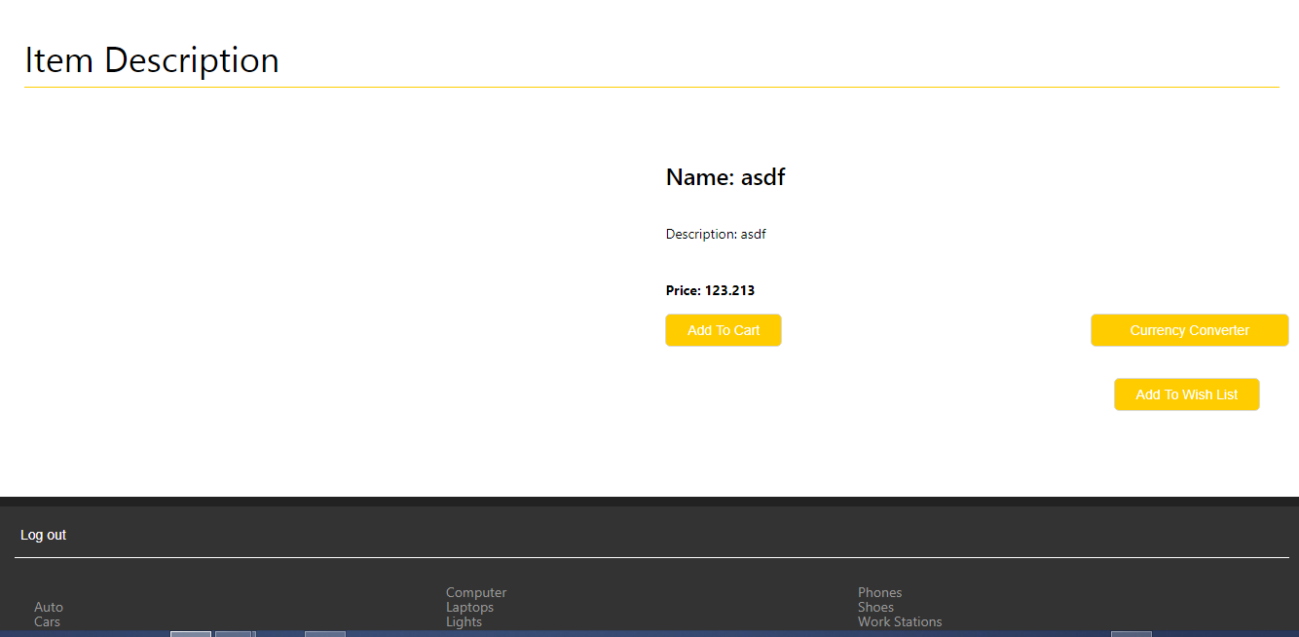
Item description

Slide 4
how it works
get id of items from requesting system
based on id its search details of items from shola data base
get information from shola database
return values that gets from data base
display item details

